Slide 1


Kevin Pordon
April 20th 2025

Slide 2

Outline
Executive Summary
Introduction
Methodology
Results
Conclusion
Appendix

Slide 3
Executive Summary
This project utilized descriptive and inferential methods to examine and predict Falcon 9 first-stage landing success
Data visualization helped tell the story of Falcon 9’s progress and high success rate
The most salient finding was the accuracy of machine learning models in predicting landing success, helping to determine total launch cost
Without similar cost savings, competitors will face difficulties underbidding SpaceX Falcon 9 launches

Slide 4
Introduction
SpaceX launch cost savings over competitors: $62M vs. $165M
Savings tied to first-stage landing success and reuse
Do certain factors determine landing success?
Can these factors reliably predict landing outcome?
Can competitors use this information to bid against SpaceX?

Slide 5

Section 1

Slide 6
Methodology
Executive Summary
Data collection methodology:
Collected using SpaceX API and Wikipedia web scraping in Jupyter Notebook
Perform data wrangling
Cleaned, transformed, and structured into a usable database
Perform exploratory data analysis (EDA) using visualization and SQL
Perform interactive visual analytics using Folium and Plotly Dash
Perform predictive analysis using classification models
Train-test-split, hyperparameter tuning, accuracy score, and confusion matrix

Slide 7
Data Collection – SpaceX API
Get Requests
Functions
Parsing
Decode
JSON
Convert pd
Assign
Variables
Store df
Filter
Used requests to establish 15 variables, including booster, payload, and outcome
JSON normalized into pandas dataframe
GitHub URL: https://github.com/kpordon24/DataScienceCapstone/blob/main/jupyter-labs-spacex-data-collection-api.ipynb

Slide 8
Data Collection - Scraping
Get Requests
Functions
Soup
Extract
Columns
Find all
Create
Parse dict
Store df
Used beautifulsoup to extract Wikipedia HTML table
Parse into dictionary and convert to pandas dataframe
GitHub URL: https://github.com/kpordon24/DataScienceCapstone/blob/main/jupyter-labs-webscraping.ipynb

Slide 9
Data Wrangling
Missing Data
Isnull pd
Outcome Type
8 types
Assign 0 or 1
Create
Class column
Dependent variable
Data processed to address null values and create binary outcome class
GitHub URL: https://github.com/kpordon24/DataScienceCapstone/blob/main/labs-jupyter-spacex-Data%20wrangling.ipynb

Slide 10
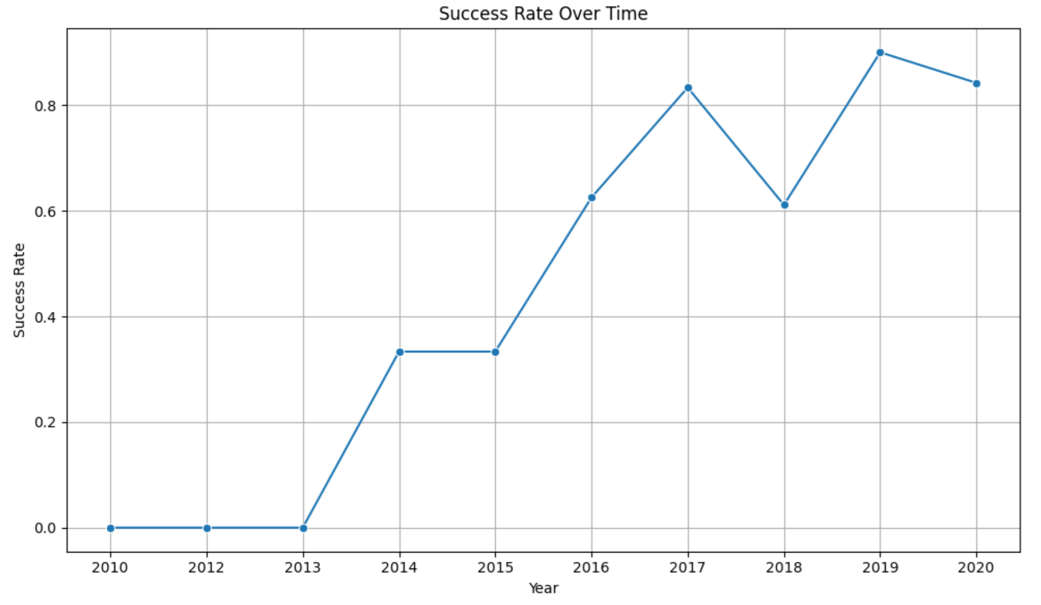
EDA with Data Visualization
Scatter plots to visualize X-Y relationships
Site vs. Flight, Orbit vs Payload, etc.
Bar graph to assess success rate by orbit
GitHub URL: https://github.com/kpordon24/DataScienceCapstone/blob/main/edadataviz.ipynb
Line plot to visualize improving success rate

Slide 11
EDA with SQL
Used SQLite to execute queries:
DISTINCT and LIKE to extract specific launch sites
SUM and AVG to extract total payload data
WHERE to extract specific combinations of variables
Subquery to extract booster versions carrying the maximum payload
GitHub URL: https://github.com/kpordon24/DataScienceCapstone/blob/main/jupyter-labs-eda-sql-coursera_sqllite.ipynb

Slide 12
Build an Interactive Map with Folium
Added map objects to visualize data spatially:
Circle markers to show launch site locations
Green/Red markers to show successes/failures for each site
Marker clusters to improve readability
Line markers to show distance from site to coastline, railway, etc.
GitHub URL: https://github.com/kpordon24/DataScienceCapstone/blob/main/lab_jupyter_launch_site_location.ipynb

Slide 13
Build a Dashboard with Plotly Dash
Added the following components:
Drop-down for launch sites
Pie chart based on site selected
Range slider to select payload
Scatter plot for success vs. payload
These help visualize key information
GitHub URL: https://github.com/kpordon24/DataScienceCapstone/blob/main/spacex-dash-app.py

Slide 14
Predictive Analysis (Classification)
Data
Std scaler
Train, test, split
Machine Learning
Create models
Evaluate
Accuracy
Optimize hyperparameters
Confusion Matrix
Used standardized independent variables to build training and testing sets
Logistic regression, SVM, decision tree, KNN models
Tuned via GridSearchCV
Score and confusion matrix to assess accuracy and error type
GitHub URL: https://github.com/kpordon24/DataScienceCapstone/blob/main/SpaceX_Machine%20Learning%20Prediction_Part_5.ipynb

Slide 15
Results
Exploratory data analysis showed time-series improvement
Folium showed proximity to coastline and infrastructure
Predictive analysis results best with decision tree model

Slide 16

Section 2

Slide 17
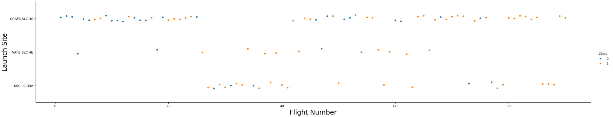
Flight Number vs. Launch Site
Show the screenshot of the scatter plot with explanations
Scatter plot showing greater success as flight number increases, specifically for site CCAFS

Slide 18
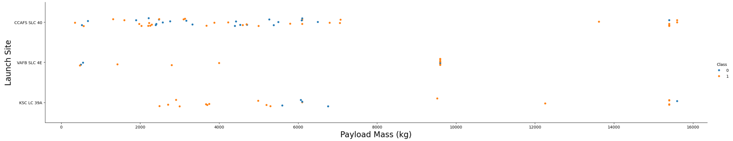
Payload vs. Launch Site
Scatter plot showing success by site and weight, note that all VAFB payloads are below 10 kg

Slide 19
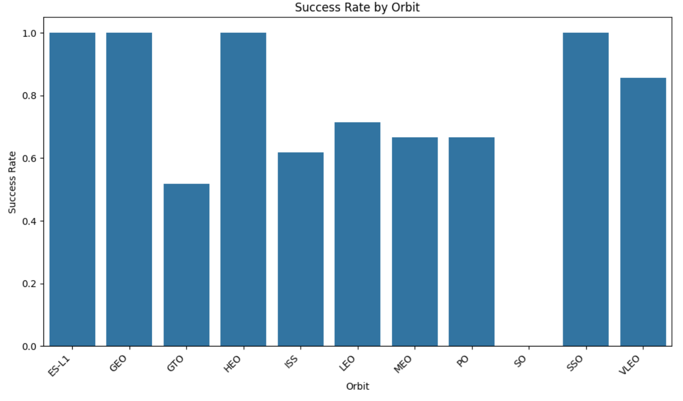
Success Rate vs. Orbit Type
Bar chart showing ES-L1, GEO, HEO, and SSO orbits had the highest success rates

Slide 20
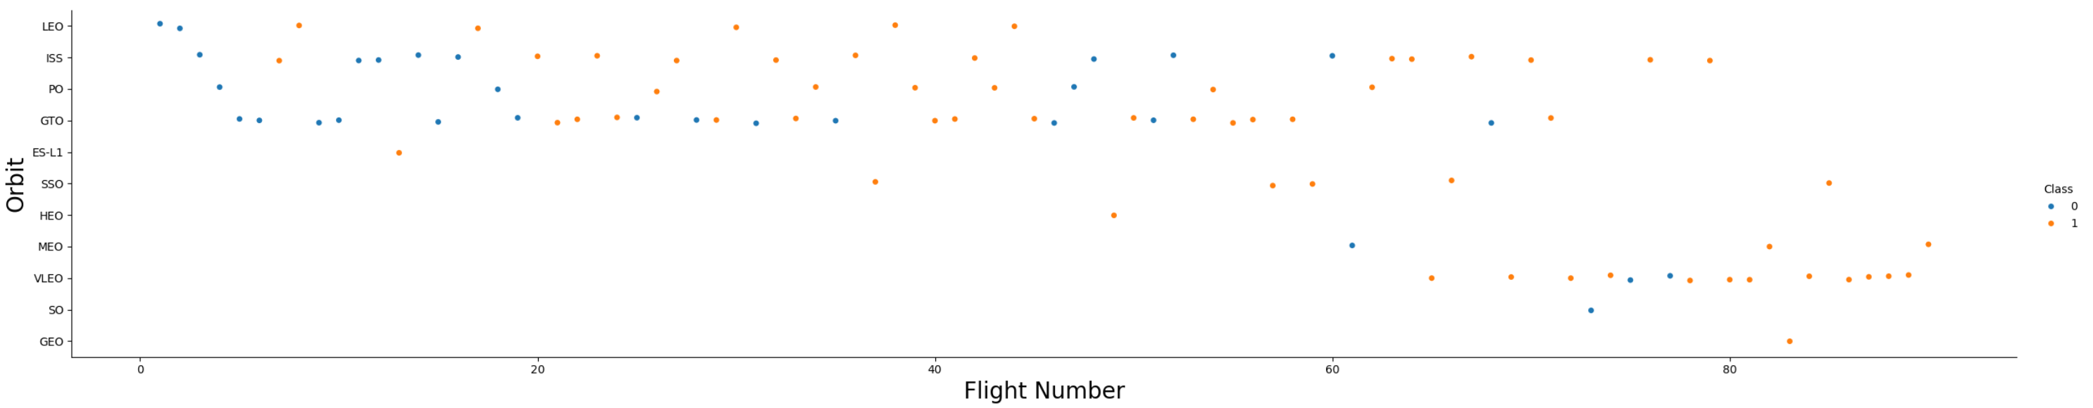
Flight Number vs. Orbit Type
Scatter plot showing outcome based on orbit and flight number, note that higher flight numbers mainly used VLEO orbit

Slide 21
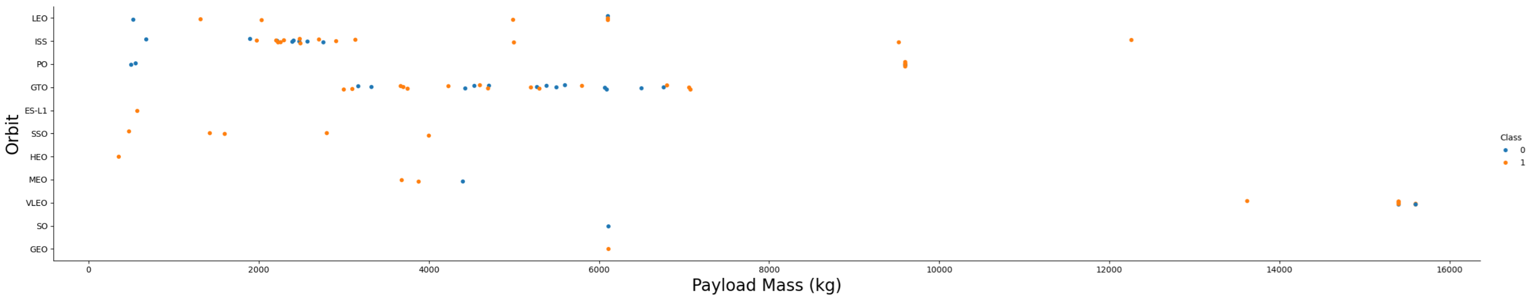
Payload vs. Orbit Type
Scatter plot illustrating mission outcomes based on orbit type and payload. While some trends are visible, the relationship between payload size and success/failure is unclear for GTO (Geostationary Transfer Orbit) missions.

Slide 22
Launch Success Yearly Trend
Time-series chart showing increasing success rate between 2010 and 2020

Slide 23
All Launch Site Names
SELECT DISTINCT Launch_Site FROM SPACEXTABLE;
Returned the following unique sites:
Launch_Site
CCAFS LC-40
VAFB SLC-4E
KSC LC-39A
CCAFS SLC-40

Slide 24
Launch Site Names Begin with 'CCA'
SELECT * FROM SPACEXTABLEWHERE Launch_Site LIKE 'CCA%' LIMIT 5;
Returned the first five entries beginning with ‘CCA’
Date | Time (UTC) | Booster_Version | Launch_Site | Payload | PAYLOAD_MASS__KG_ | Orbit | Customer | Mission_Outcome | Landing_Outcome
2010-06-04 | 18:45:00 | F9 v1.0 B0003 | CCAFS LC-40 | Dragon Spacecraft Qualification Unit | 0 | LEO | SpaceX | Success | Failure (parachute)
2010-12-08 | 15:43:00 | F9 v1.0 B0004 | CCAFS LC-40 | Dragon demo flight C1, two CubeSats, barrel of Brouere cheese | 0 | LEO (ISS) | NASA (COTS) NRO | Success | Failure (parachute)
2012-05-22 | 7:44:00 | F9 v1.0 B0005 | CCAFS LC-40 | Dragon demo flight C2 | 525 | LEO (ISS) | NASA (COTS) | Success | No attempt
2012-10-08 | 0:35:00 | F9 v1.0 B0006 | CCAFS LC-40 | SpaceX CRS-1 | 500 | LEO (ISS) | NASA (CRS) | Success | No attempt
2013-03-01 | 15:10:00 | F9 v1.0 B0007 | CCAFS LC-40 | SpaceX CRS-2 | 677 | LEO (ISS) | NASA (CRS) | Success | No attempt

Slide 25
Total Payload Mass
SELECT SUM(PAYLOAD_MASS__KG_) FROM SPACEXTABLE WHERE Customer = "NASA (CRS)";
Returned the total payload mass for all entries:
SUM(PAYLOAD_MASS__KG_)
45596

Slide 26
Average Payload Mass by F9 v1.1
SELECT AVG(PAYLOAD_MASS__KG_) FROM SPACEXTABLE WHERE Booster_Version LIKE "F9 v1.1";
Returned the average payload mass for all ‘F9 v1.1’ entries:
AVG(PAYLOAD_MASS__KG_)
2928.4

Slide 27
First Successful Ground Landing Date
SELECT MIN(Date) FROM SPACEXTABLE WHERE Landing_Outcome = "Success (ground pad)";
Returned the earliest date for a successful outcome:
MIN(Date)
2015-12-22

Slide 28
Successful Drone Ship Landing with Payload between 4000 and 6000
SELECT Booster_Version, PAYLOAD_MASS__KG_ FROM SPACEXTABLEWHERE Landing_Outcome = 'Success (drone ship)'AND PAYLOAD_MASS__KG_ BETWEEN 4001 AND 5999;
Returns booster versions with successful drone ship landings in the range:
Booster_Version | PAYLOAD_MASS__KG_
F9 FT B1022 | 4696
F9 FT B1026 | 4600
F9 FT B1021.2 | 5300
F9 FT B1031.2 | 5200

Slide 29
Total Number of Successful and Failure Mission Outcomes
SELECT Landing_Outcome, COUNT(Landing_Outcome) AS Total_Count FROM SPACEXTABLEWHERE Landing_Outcome LIKE 'Success%' OR Landing_Outcome Like 'Failure%'GROUP BY Landing_Outcome;
Returned total count based on outcome type:
Landing_Outcome | Total_Count
Failure | 3
Failure (drone ship) | 5
Failure (parachute) | 2
Success | 38
Success (drone ship) | 14
Success (ground pad) | 9

Slide 30
Boosters Carried Maximum Payload
Booster_Version
F9 B5 B1048.4
F9 B5 B1049.4
F9 B5 B1051.3
F9 B5 B1056.4
F9 B5 B1048.5
F9 B5 B1051.4
F9 B5 B1049.5
F9 B5 B1060.2
F9 B5 B1058.3
F9 B5 B1051.6
F9 B5 B1060.3
F9 B5 B1049.7
SELECT DISTINCT Booster_Version FROM SPACEXTABLEWHERE PAYLOAD_MASS__KG_ = (SELECT MAX(PAYLOAD_MASS__KG_) FROM SPACEXTABLE);
Returned unique booster versions that have carried the max payload:

Slide 31
2015 Launch Records
SELECT substr(Date, 6, 2) AS Month, Landing_Outcome, Booster_Version, Launch_Site FROM SPACEXTABLEWHERE substr(Date, 0, 5) = '2015'AND Landing_Outcome = 'Failure (drone ship)’;
Returned month of failure landing outcomes for drone ship:
Month | Landing_Outcome | Booster_Version | Launch_Site
01 | Failure (drone ship) | F9 v1.1 B1012 | CCAFS LC-40
04 | Failure (drone ship) | F9 v1.1 B1015 | CCAFS LC-40

Slide 32
Rank Landing Outcomes Between 2010-06-04 and 2017-03-20
SELECT DISTINCT Landing_Outcome, COUNT(Landing_Outcome) AS Outcome_Count FROM SPACEXTABLEWHERE Date BETWEEN '2010-06-04' AND '2017-03-20'GROUP BY Landing_OutcomeORDER BY Outcome_Count DESC;
Returns landing outcomes in the range, ranked by number of occurrences:
Landing_Outcome | Outcome_Count
No attempt | 10
Success (drone ship) | 5
Failure (drone ship) | 5
Success (ground pad) | 3
Controlled (ocean) | 3
Uncontrolled (ocean) | 2
Failure (parachute) | 2
Precluded (drone ship) | 1

Slide 33

Section 3

Slide 34
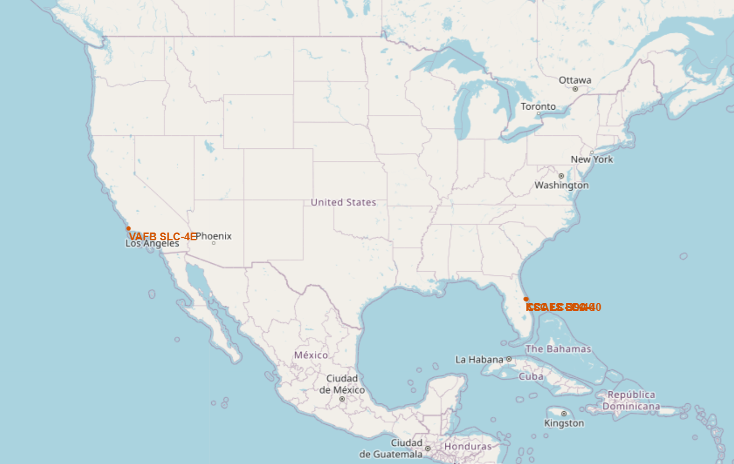
Launch Sites Map
All launch sites are located in coastal areas

Slide 35
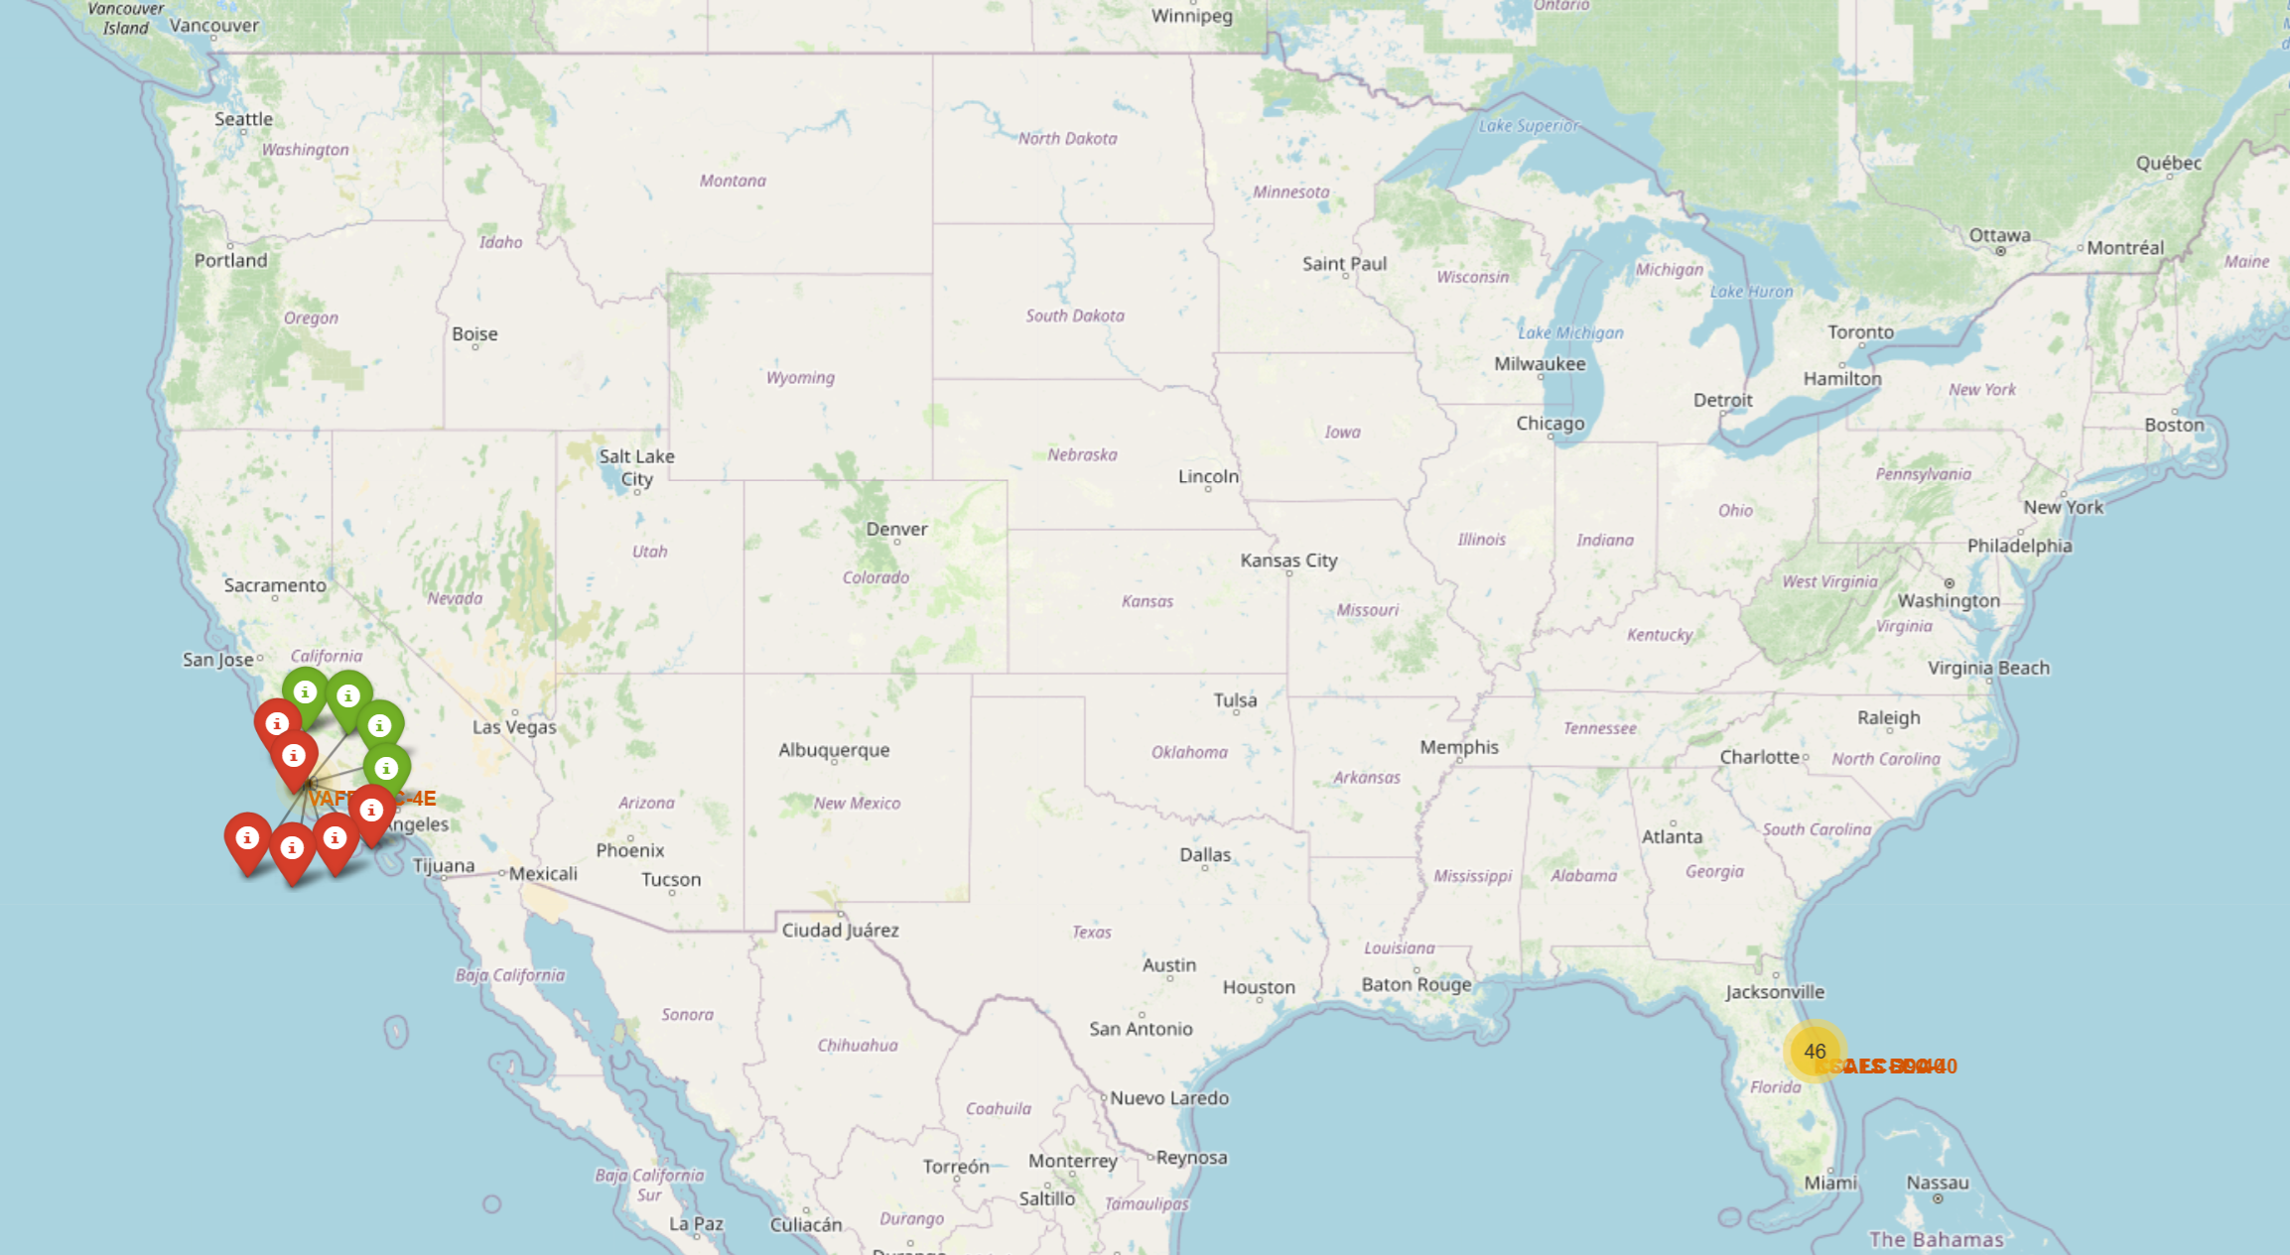
Launch Outcomes Map
Successful outcomes are denoted in green while failures are shown in red

Slide 36
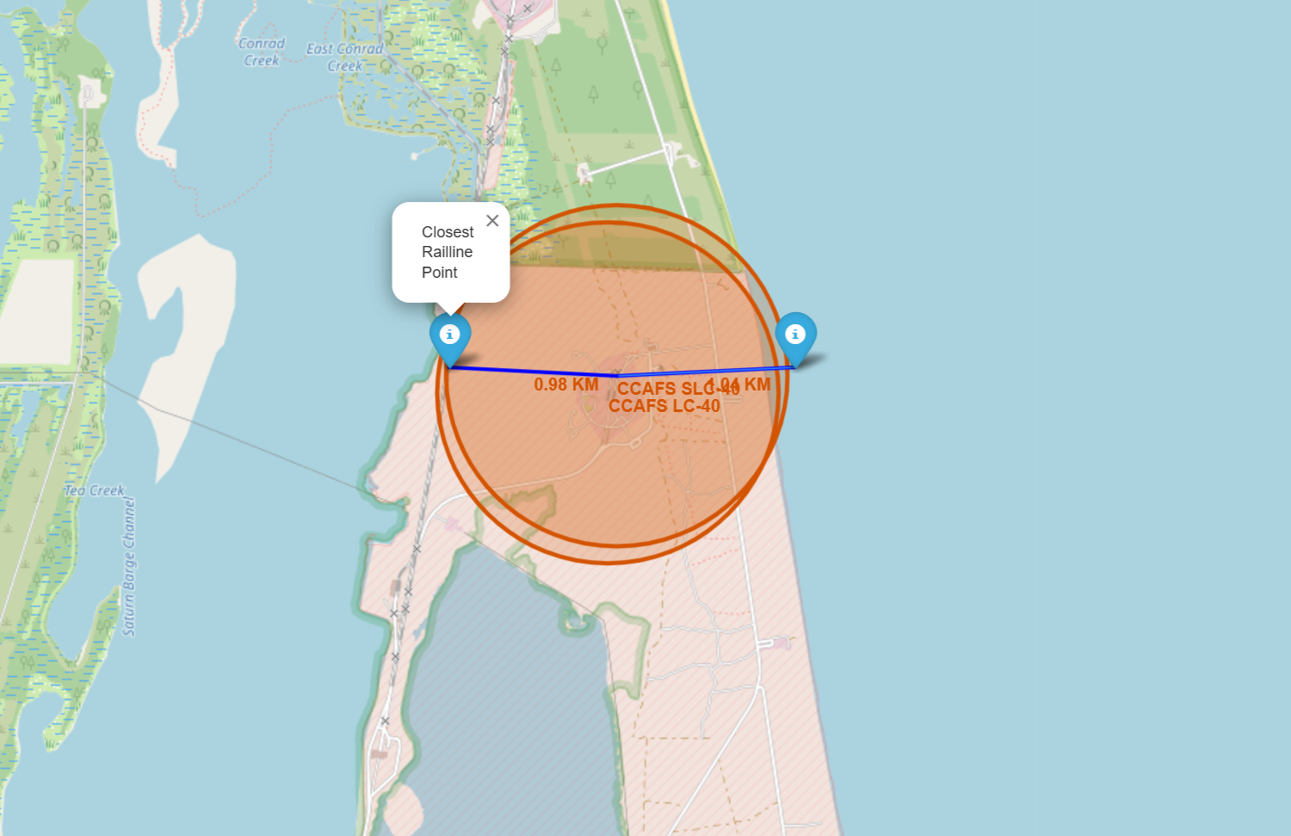
Proximity Map
Map showing distance from launch site to rail and coastline

Slide 37

Section 4

Slide 38
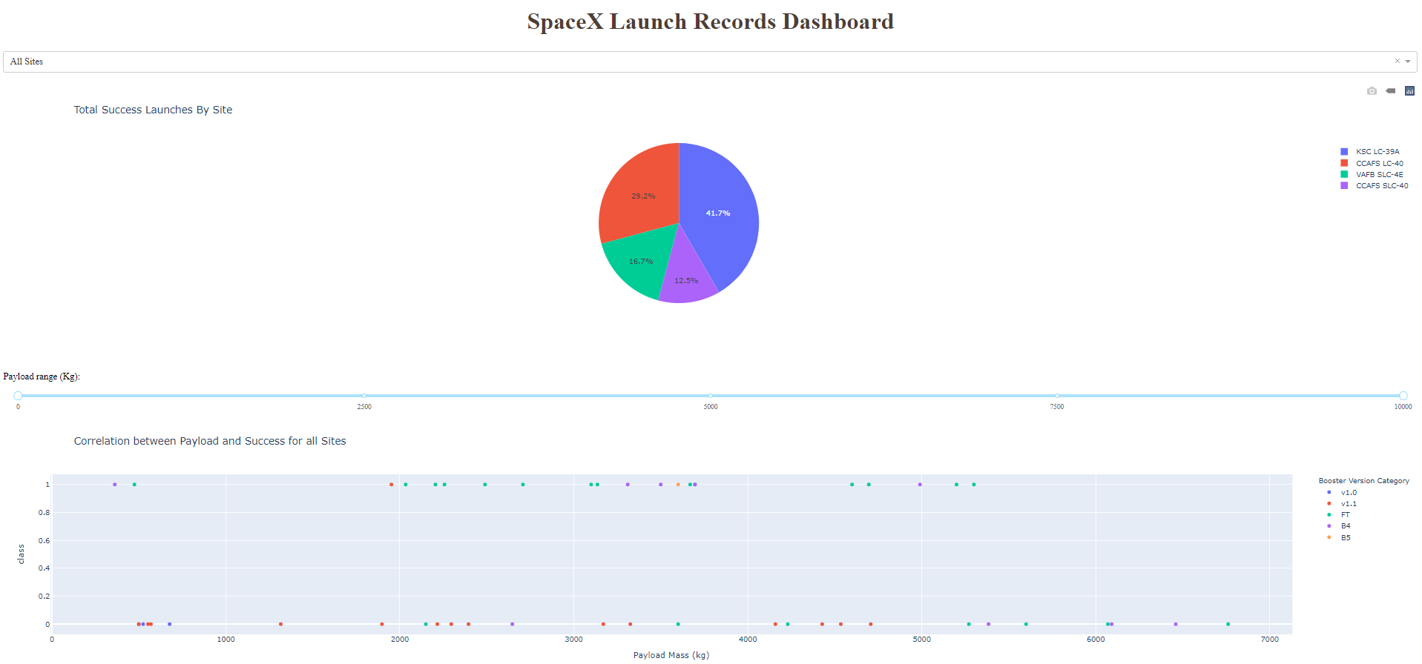
Launch Success Pie Chart
Dashboard showing percentage of successes by site

Slide 39
<Dashboard Screenshot 2>
Replace <Dashboard screenshot 2> title with an appropriate title
Show the screenshot of the piechart for the launch site with highest launch success ratio
Explain the important elements and findings on the screenshot

Slide 40
<Dashboard Screenshot 3>
Replace <Dashboard screenshot 3> title with an appropriate title
Show screenshots of Payload vs. Launch Outcome scatter plot for all sites, with different payload selected in the range slider
Explain the important elements and findings on the screenshot, such as which payload range or booster version have the largest success rate, etc.

Slide 41

Section 5

Slide 42
Classification Accuracy
All machine learning models performed well in terms of prediction accuracy, with decision tree exhibiting the highest accuracy.

Slide 43
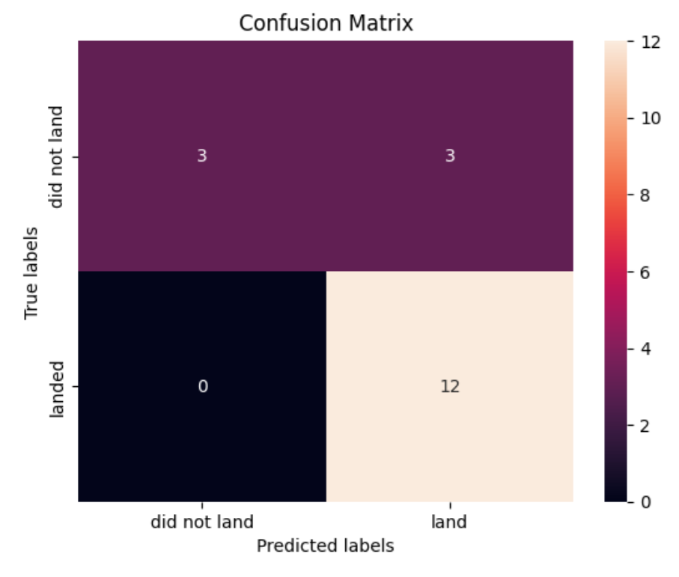
Confusion Matrix
Decision tree matrix shows three incorrect classifications where the first stage did not land but the model predicted it as a success

Slide 44
Conclusions
Falcon 9 landing success has improved drastically over time
Site, booster type, payload, and orbit type are important predictors
Machine learning algorithms are powerful predictors of landing outcome with exception of a few false positives
With the recent consistency in successful outcomes, competitors will have difficulty bidding against SpaceX without similar cost savings

Slide 45


